Slide 1


Data processing using python
Supervisor: dr.Soha Nagy
Represented by nada mohamed abbas

Slide 2

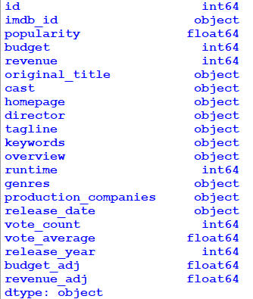
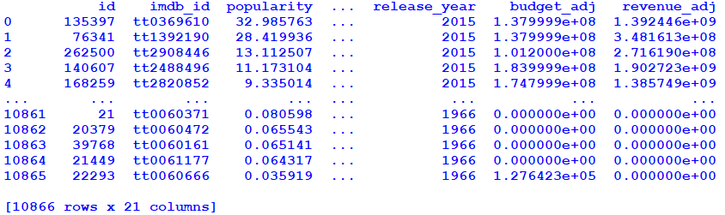
1. Import data to python

Slide 3
2. Cleaning the data

Slide 4
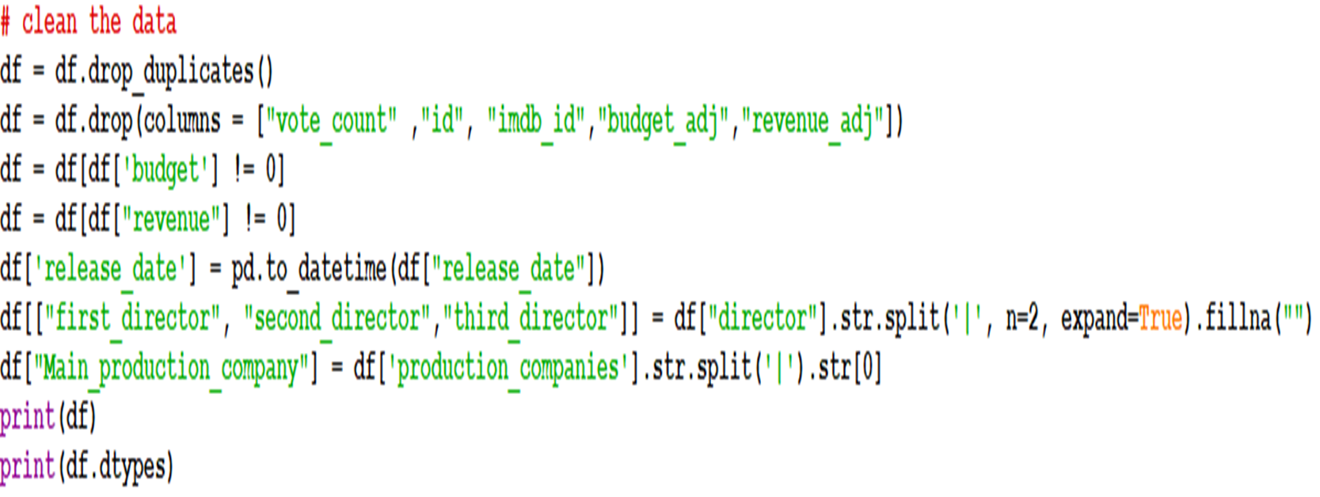
Remove duplicates
remove unnecessary columns
remove null values in budget and revenue columns
change the format of release date from object to date
split the director column
Extract the first company from production companies' column

Slide 5
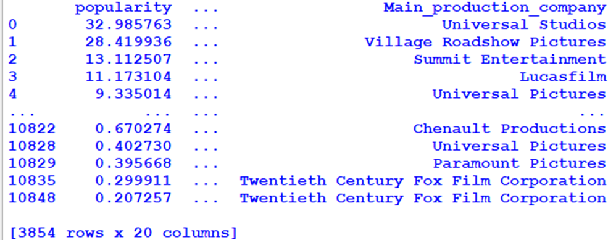
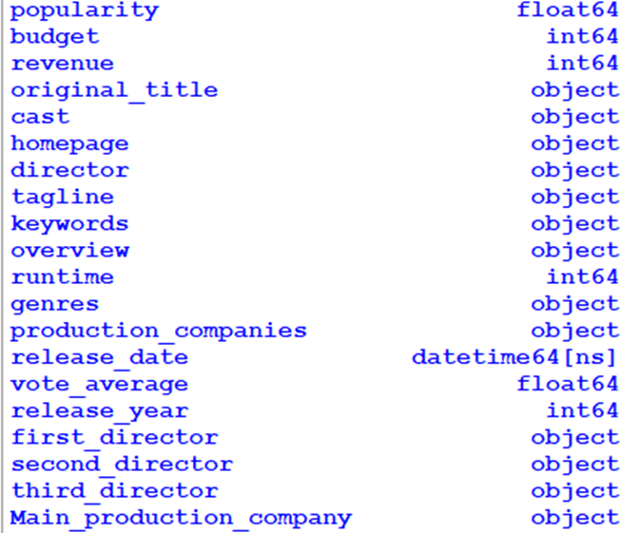
Data after cleaning

Slide 6

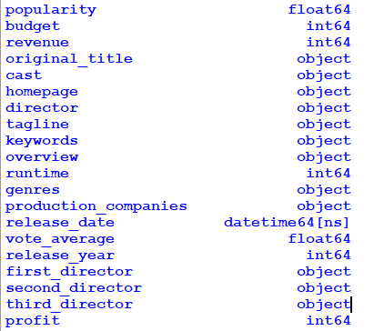
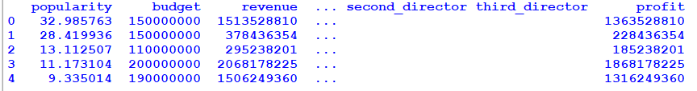
3. Make calculations on data

Slide 7
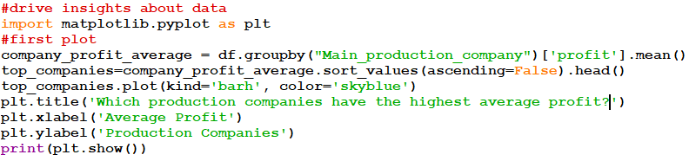
4. Drive insights from data

Slide 8
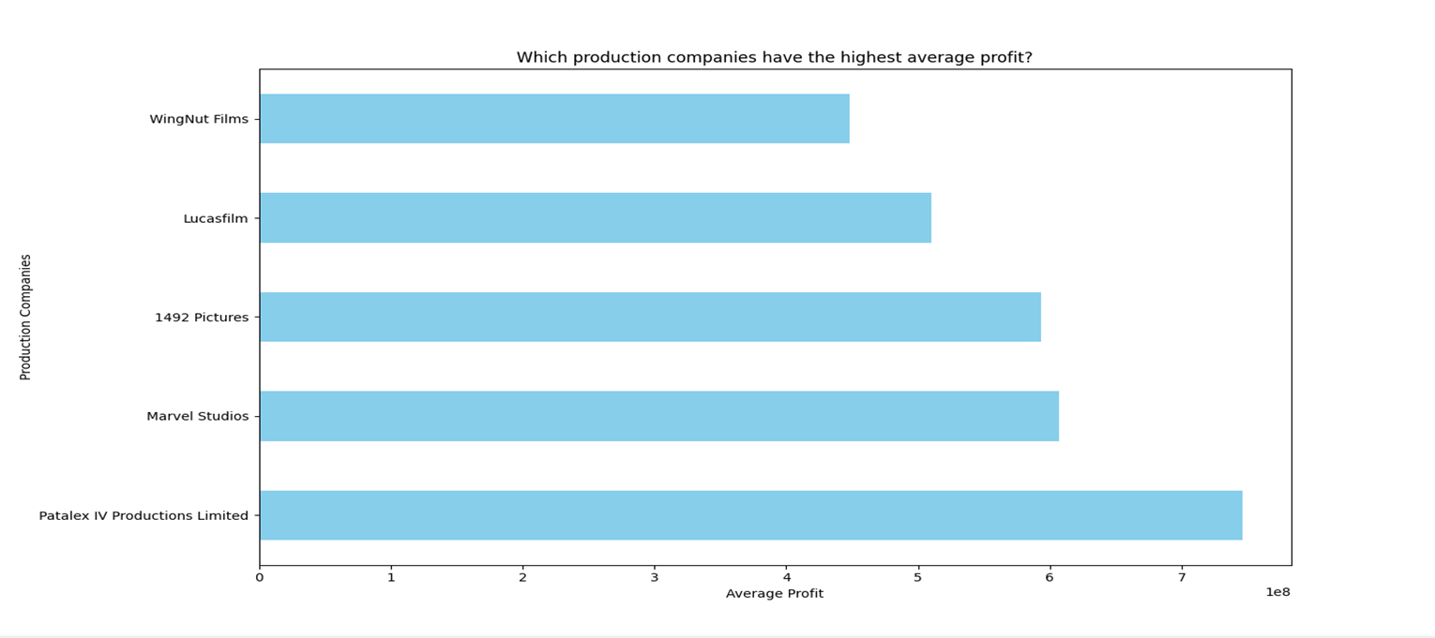

Slide 9
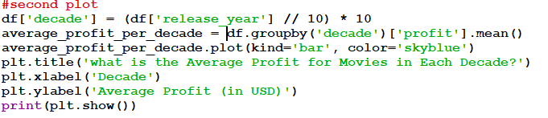
4. Drive insights from data

Slide 10
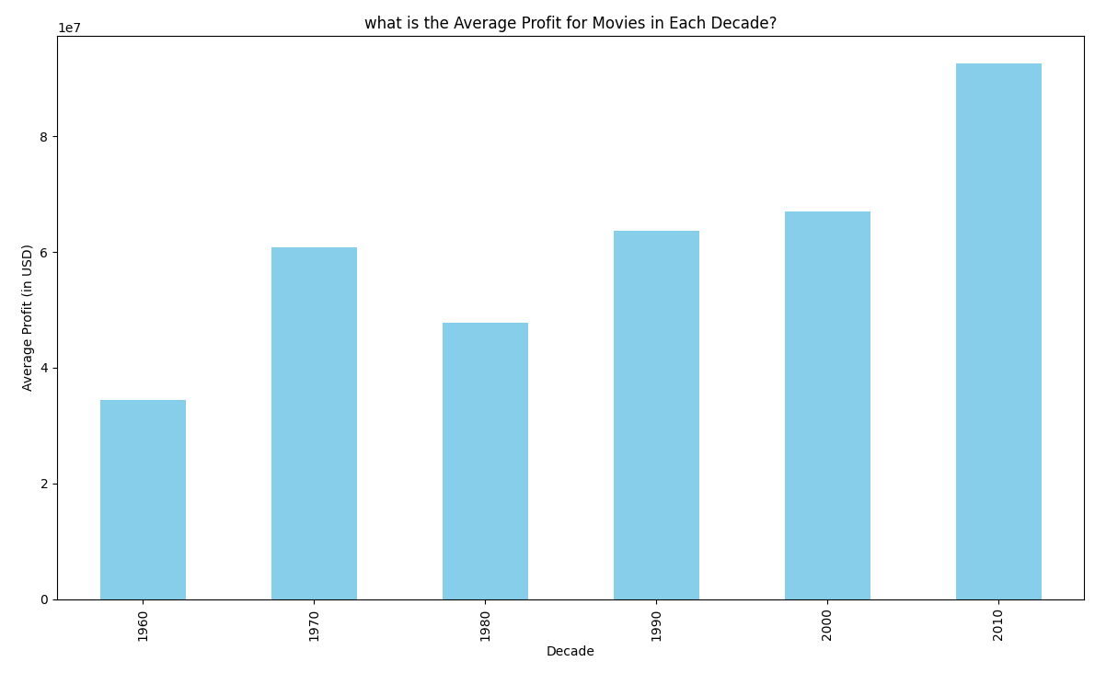

Slide 11
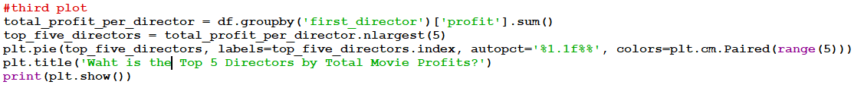
4. Drive insights from data

Slide 12
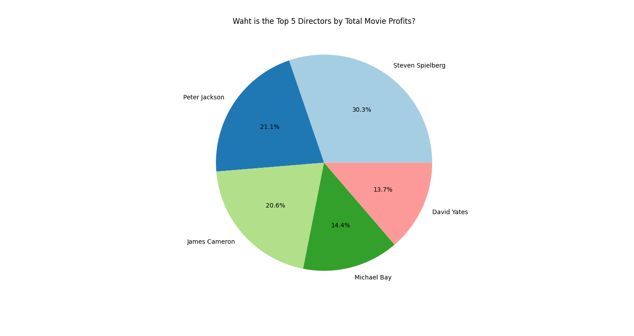

Slide 13
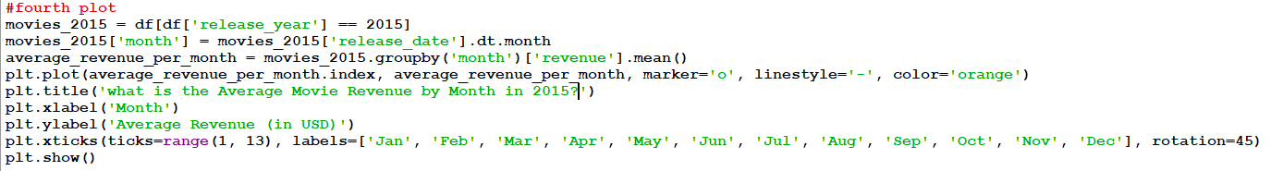
4. Drive insights from data

Slide 14
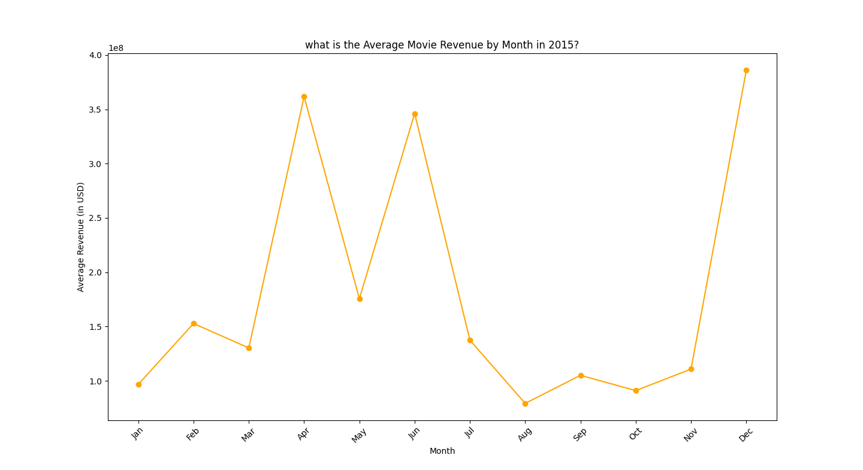

Slide 15
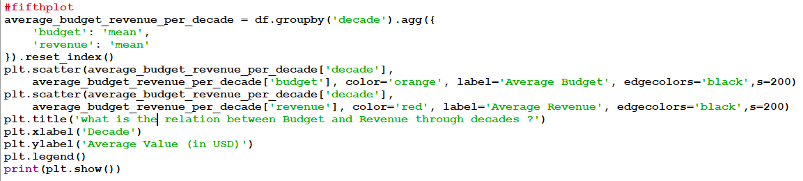
4. Drive insights from data

Slide 16
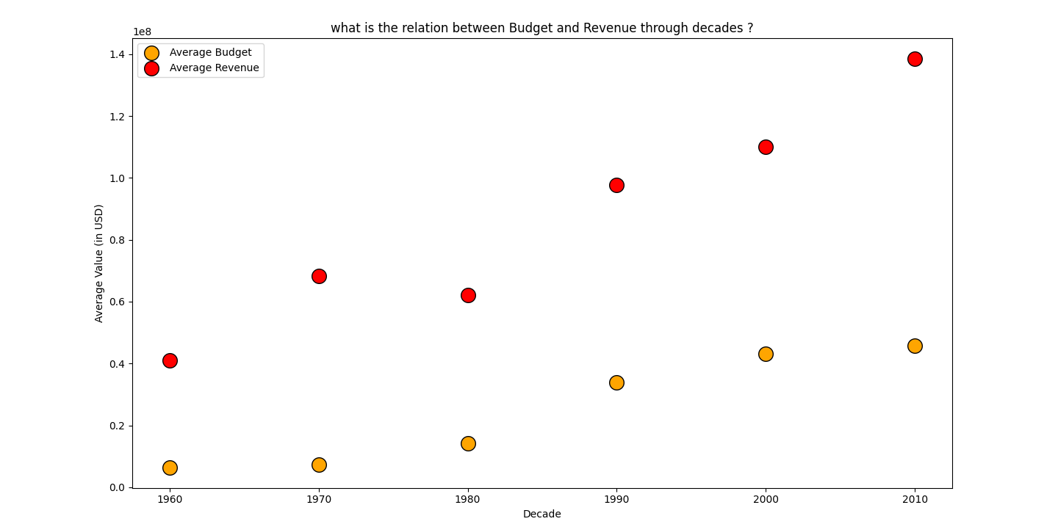

Slide 17
Thanks
Supervisor: dr.Soha Nagy
Represented by nada mohamed abbas

